Slide 1
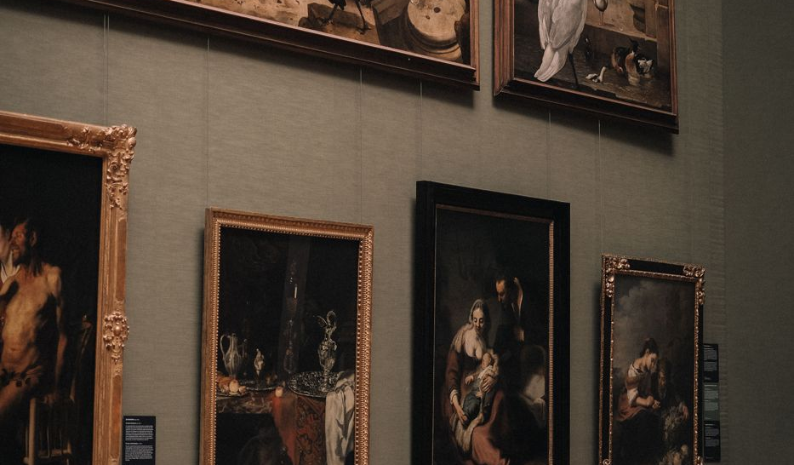

Fourth Quarter Business Review
Atkins and Associates Fine Wines | October to December 2025
Prepared with Susan Bradley for the leadership review
$975K
$61,575
$89.7K
12%
Team sales, Q4
Commissions paid
Top six accounts
YoY growth
A solid close to the year. Team sales held at 975,000 dollars across four representatives, with commissions of 61,575 dollars paid. Six key accounts delivered 89,720 dollars in tracked orders heading into the Italian launch.

Slide 2
Sales Performance by Representative
Rep | Sales | Comm
Maria Lopez | 320,000 | 16,000
Tom Becker | 285,000 | 14,250
Rachel Green | 250,000 | 12,500
Brian Harper | 120,000 | 18,825
Total | 975,000 | 61,575
Brian Harper earns a 1.5 percent override on rep sales, plus base commission.

Slide 3
Key Account Orders, Q4
Headline
Le Jardin Dore remains the largest single account at 30,700 dollars across the quarter. Six accounts delivered 89,720 dollars in tracked orders.

Slide 4
Portfolio Mix and Margin
Average gross margin by wine
Wine | Margin
Coastal Oak Sauv Blanc | 58.8%
Vista Loma Zinfandel | 58.6%
Paso Sierra Syrah | 57.7%
Stonecreek Chardonnay | 56.8%
Whitfield Estate Cabernet | 52.6%

Slide 5
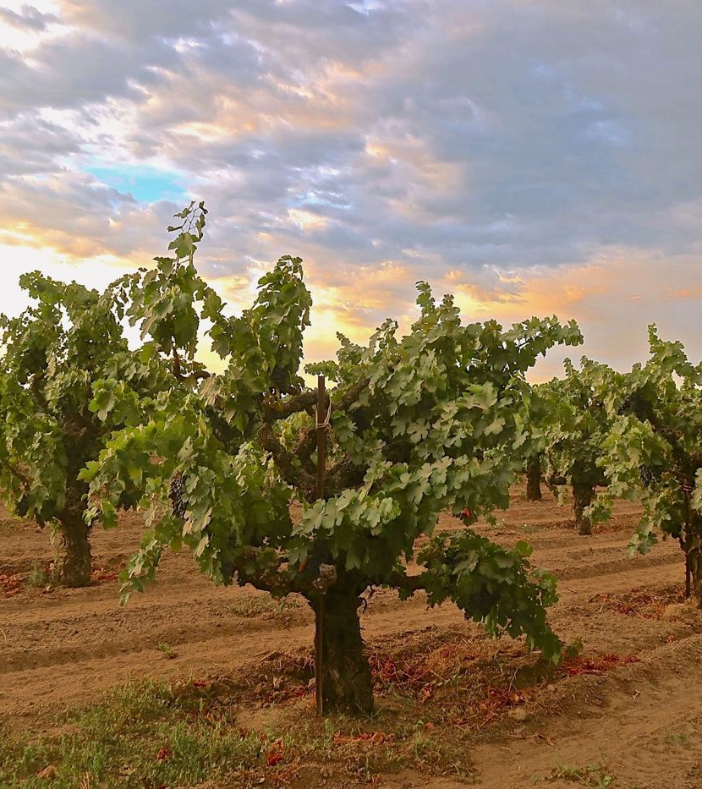
Outlook into 2026
Launch the Italian program after legal review and the October trip
Hold the holiday client gift shipments deadline of December 15, 2026
Watch European tariff exposure on incoming wine duties
Sustain 12 percent growth on the base portfolio
Convert prospect restaurant accounts in the pipeline

